Slide 1
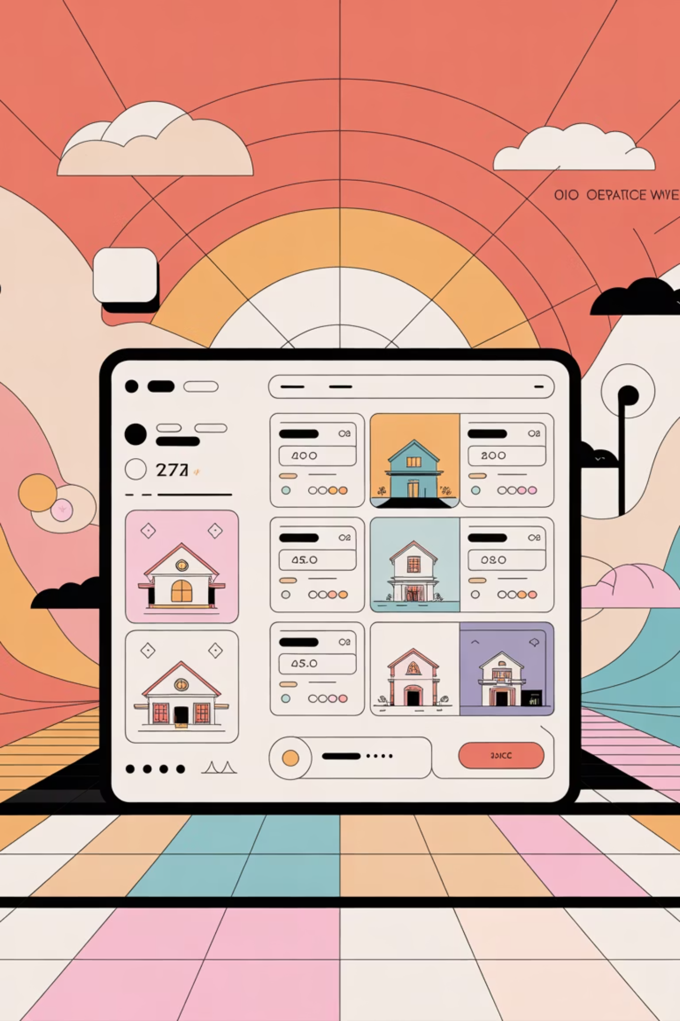
Unlocking Intelligent Property Discovery
Turning Complex Real-Estate Search Into Personalized AI-Driven Insights
Harnessing Hybrid Search & AI to Deliver Fast, Accurate, and Contextual Property Matches at Scale.
Modern AI transforms messy, data-heavy real estate discovery into an intuitive, user-centric experience with measurable impact on decision-making and business growth.

Slide 2


The Problem: Fragmented Search, Missed Opportunities
Cumbersome & Fragmented Search
Failure to Understand Preferences
Users navigate static filters or multiple portals, wading through thousands of irrelevant listings to find what they need. This leads to user fatigue and lost opportunities.
Traditional search engines struggle with natural language queries like "pet-friendly, under $800k, near transit," resulting in poor matches and low engagement.

Slide 3




The Solution: AI-Powered Hybrid Search
Our AI Agent combines the best of both worlds to deliver superior real estate discovery.
Traditional Keyword Search
Ensures precise retrieval of structured criteria and exact matches.
Semantic Search (Vector)
Understands the meaning and context of user preferences for intelligent matching.
LLM Conversational Interface
Engages users in natural language, enabling intuitive interaction and refinement.

Slide 4
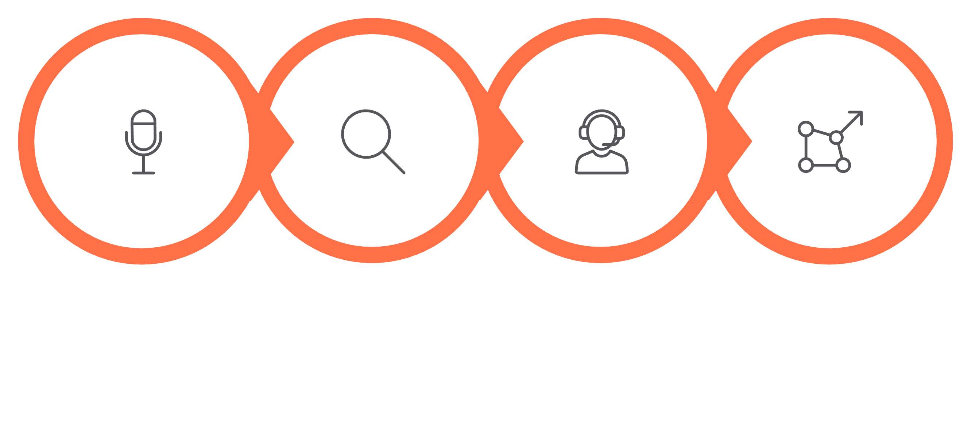
Core Technical Architecture
Hybrid Search
Input Layer
LLM Agent
Vector DB
This robust architecture ensures high-precision retrieval and user-friendly insights, transforming raw data into actionable information.

Slide 5





Intuitive User Experience Flow
From query to recommendation, our system guides users seamlessly to their ideal property.
Natural Query
Users articulate preferences in natural language.
Hybrid Analysis
System processes query using semantic and keyword search.
Top Matches
Presents highly relevant property listings.
Interactive Refinement
Users clarify needs via conversational interface.
Refined Recommendations
Delivers precise, personalized property suggestions.

Slide 6
Driving Business Value & Impact
Our AI-powered hybrid search translates directly into measurable business benefits.
Increased Match Accuracy
Faster Search Speed
Higher relevance scores lead to better user satisfaction.
Reduced time-to-match for agents and buyers.
Higher Conversion Rates
Enhanced Engagement
More inquiries and successful transactions.
Improved user retention and repeat visits.

Slide 7
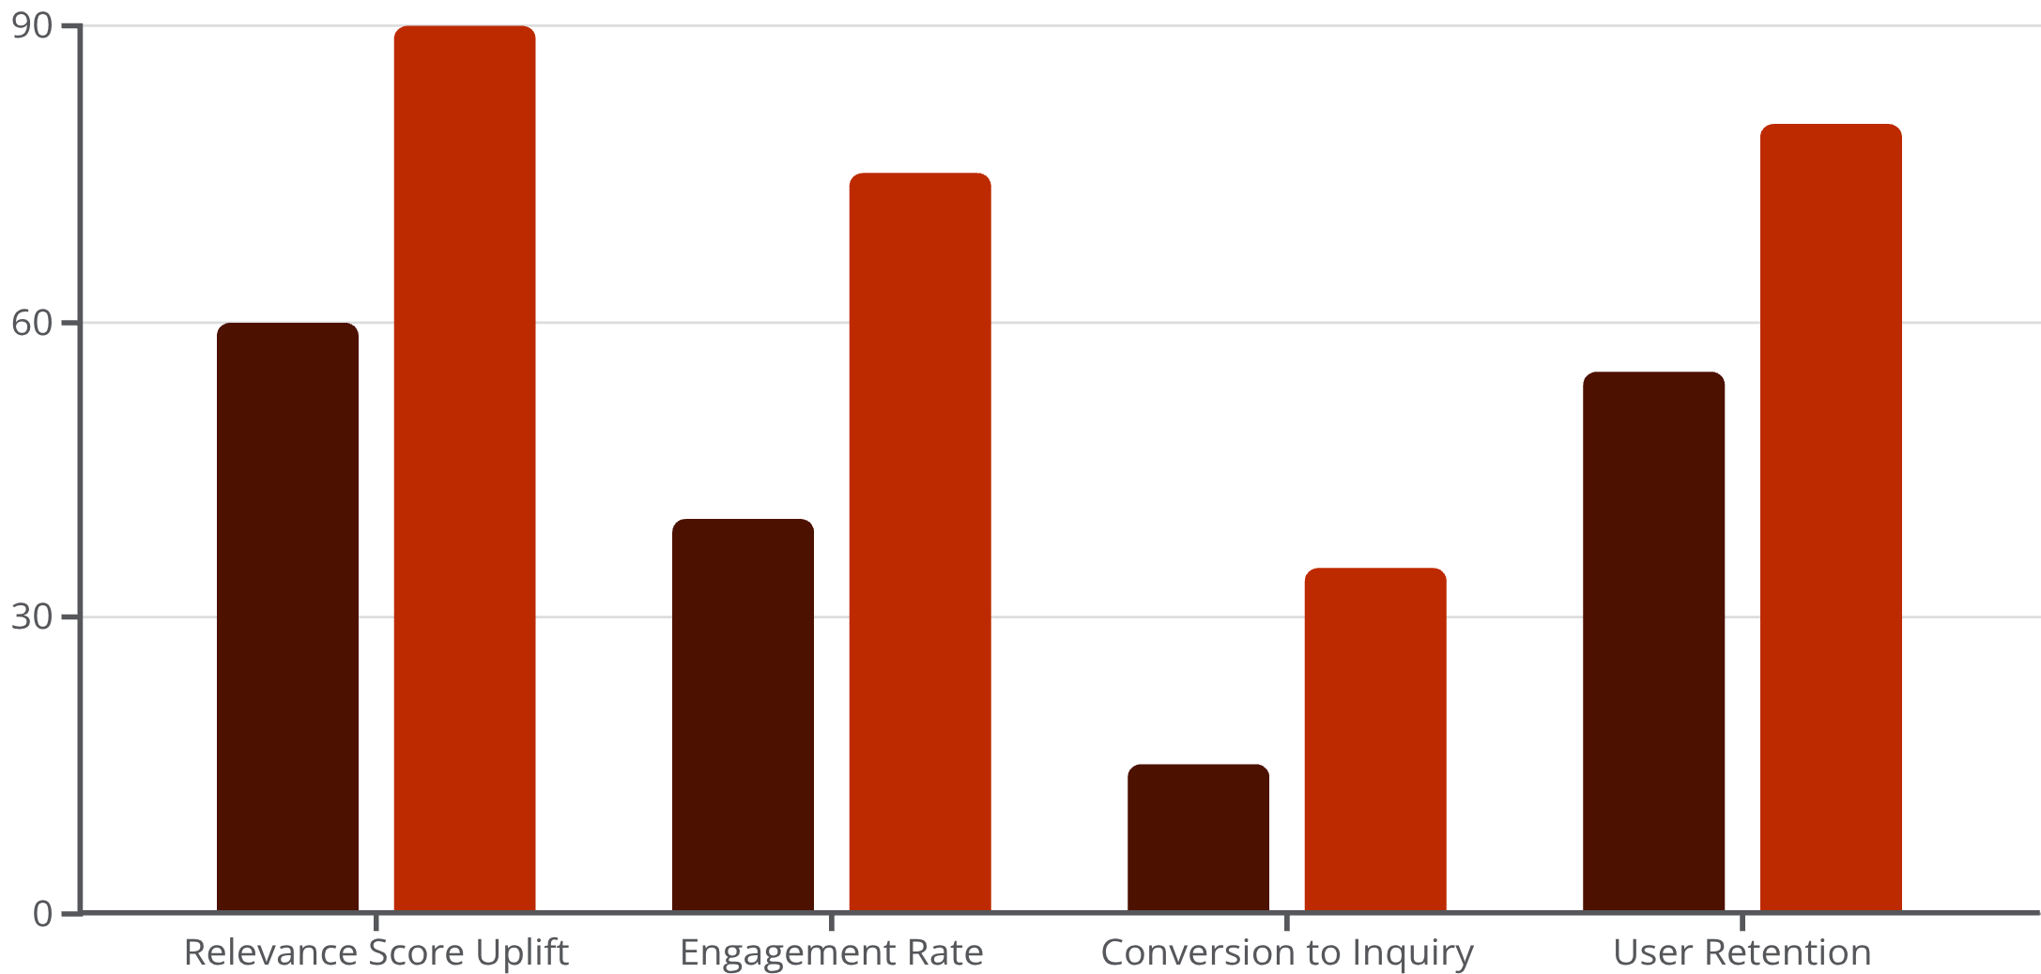
Key Metrics for Success
Our predictive analytics show significant improvements across critical performance indicators compared to traditional search methods. We anticipate a substantial uplift in user satisfaction and operational efficiency.
Relevance Score Uplift: Up to 50%
Engagement Rate: Increased by 35%
Conversion from Search to Inquiry: Doubled
User Retention: Improved by 25%
Traditional
Hybrid AI

Slide 8
Commercialization Strategy
Capturing market share through versatile product offerings.
SaaS Platform
APIs & Plugins
Monetization
Full-featured solution for property portals, agencies, and enterprise brands.
Embed hybrid search UI into existing MLS systems, brokerages, and CRM integrations.
Subscription tiers, personalized insights reports, and premium analytics dashboards.

Slide 9
Go-to-Market & Vision
A phased approach to establish market leadership and drive widespread adoption.
Phase 1: Pilot Programs
Phase 3: White-Label Solutions
Engage with select partners to validate and refine the solution.
Offer customizable solutions for diverse market needs and brands.
Phase 2: Scalable Deployment
Roll out to broader market segments, including property listing sites and broker networks.
Our vision is to become the indispensable AI-powered discovery engine for the global real estate market.

Slide 10

Redefining Real Estate Discovery
Our AI-powered hybrid search agent addresses the core pain points of traditional property search, offering an intuitive, efficient, and highly accurate solution. This innovation promises to unlock significant value, driving engagement, conversions, and a new era of intelligent property insights.
The future of real estate is intelligent, personalized, and seamless.

